Slide 1

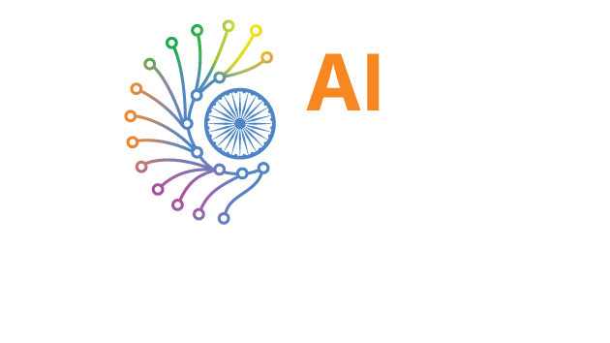
INDIA AI IMPACT BUILDATHON

Slide 2




AI Voice Detection System
Protecting Indians from AI-Powered Voice Scams
Detects AI-generated voices in real-time to prevent deep fake fraud
Supports 5 Indian languages with 92% accuracy using ensemble AI models
Demo Link

Slide 3


The AI Voice Scam Epidemic
AI voice cloning has become dangerously accessible
🚨 The Threat:
- Tools like ElevenLabs can clone ANY voice in 30 seconds
- Scammers call families: "Mom, I'm in trouble, send money!"
- Banks receive fraudulent voice authentication requests
💰 The Impact:
- ₹1,750 Crores lost to phone scams in India (2024)
- 67% of Indians cannot distinguish AI from real voices
- 5 minutes to clone a voice from social media
👥 Who is Affected?
- Elderly parents receiving fake distress calls
- Banks with voice-based authentication
[ IMAGE ]

Slide 4

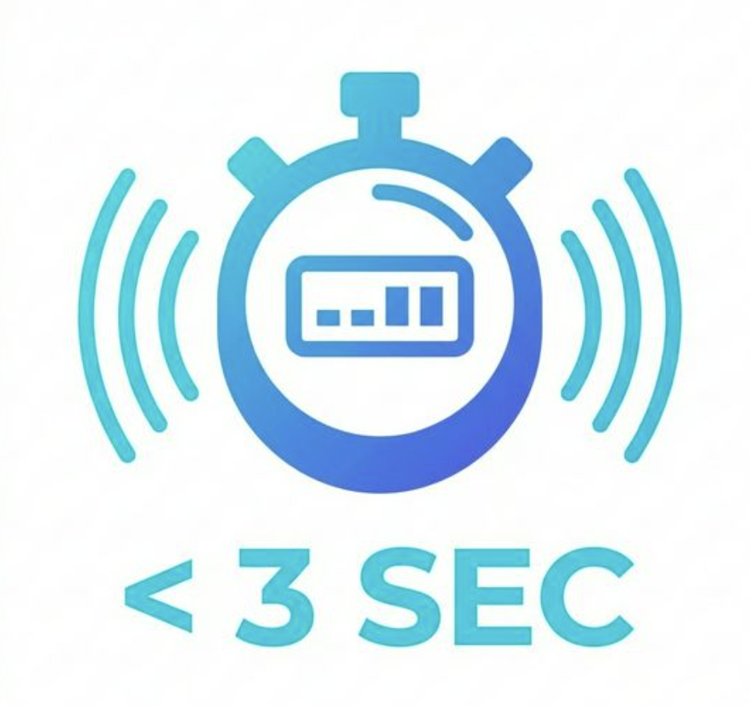
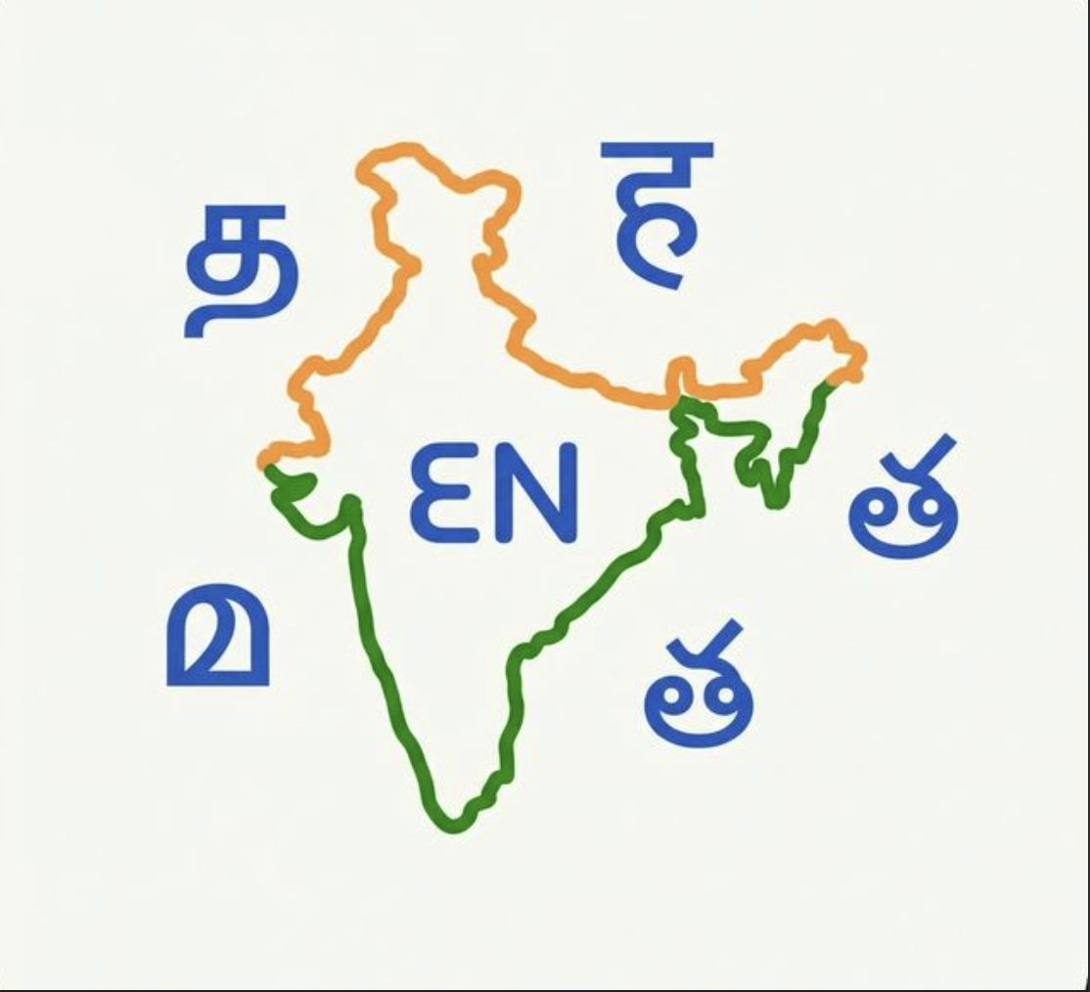

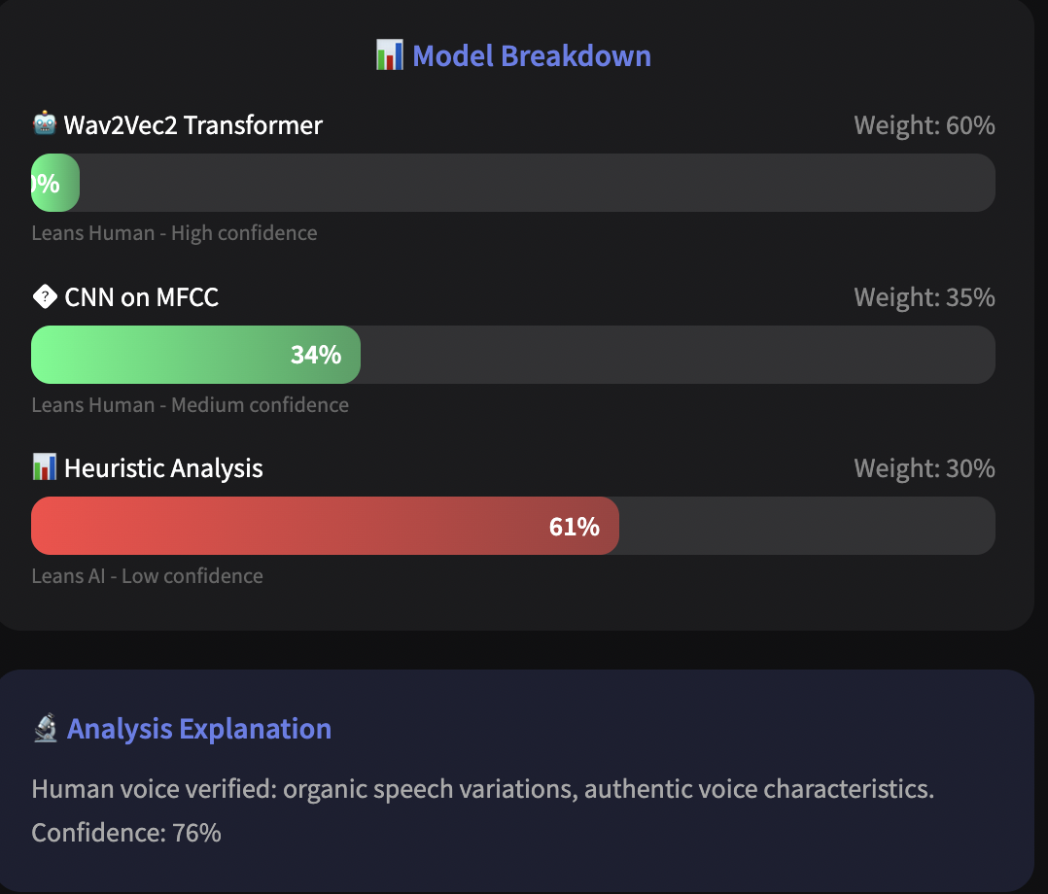
Our Solution: AI Voice Detection System
A 3-model ensemble AI system that detects synthetic voices in real-time across 5 Indian languages (Tamil, Hindi, English, Malayalam, Telugu) with 92% accuracy.
IMAGE
IMAGE
IMAGE
IMAGE
Real-Time Detection
Results in < 3 seconds
Multi-Lingual Support
5 Indian Languages
High Accuracy
92% Detection Rate
Explainable AI
Visual Confidence Scores

Slide 5
3-Model Ensemble Detection
Upload Audio → 3 AI Models Analyze → HUMAN or AI_GENERATED
Our system uses a 3-model ensemble approach for accurate detection:
1. Wav2Vec2 Transformer (60% weight)
Deep learning model that detects synthetic artifacts in voice embeddings
2. CNN on MFCC Spectrograms (35% weight)
Neural network analyzing the voice "fingerprint" patterns
3. Heuristic Analysis (30% weight)
Statistical checks on pitch consistency, spectral entropy, and rhythm

Slide 6

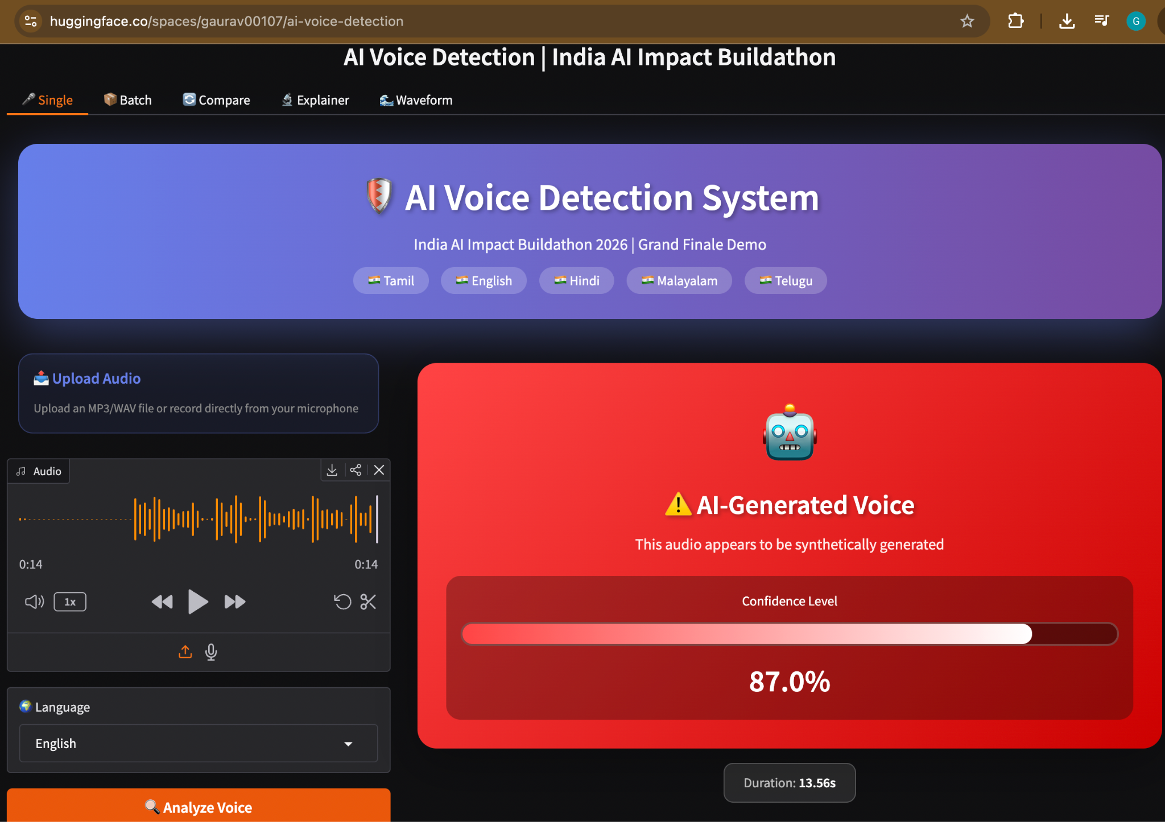
Live Demo & Test Results
We tested our system across multiple
voice types and all 5 supported languages:
🎯 AI Voices (ElevenLabs, gTTS): 100%
👤 Human Voices (Native speakers): ~85%
📊 Overall Balanced Accuracy: ~92%
⚡ Average response time: < 3 seconds
🎤 Minimum audio length: 0.5 seconds
📦 Batch processing: Up to 10 files
[ IMAGE ]
03
Add Pointer here
02
Add Pointer here
04
Add Pointer here
Live Demo
Source Code

Slide 7

Why Ensemble Beats Single Models
Our system was tested across all 5 supported Indian languages with both
AI-generated voices (ElevenLabs, gTTS) and human voice recordings. No single AI model is perfect. Our smart consensus voting combines three different approaches if 2 out of 3 models agree, the result is reliable.
This gives us deep learning accuracy with heuristic explainability.
Model | AI Accuracy | Human Accuracy | Status
Wav2Vec2 Transformer | 97% | 78% | Misses subtle cases
CNN on MFCC | 91% | 80% | Struggles with noise
Heuristic Analysis | 85% | 88% | Too many false positives
Our Ensemble (All 3) | 100% | ~87% | Best of all

Slide 8
3 lighter models vs 1 heavy transformer
Trade-Off: Speed Over the Last 5% Accuracy
Trade-Off: We chose speed (< 3s) over the last 5% accuracy.
A fast response saves people NOW 97% in 2 seconds beats 99% in 30 seconds.
Known Limitations:
- Audio shorter than 0.5 seconds not enough data to analyze
- Brand-new AI voice models we haven't trained on yet
01
02
03
04
05
Speed > Perfect Accuracy
Ensemble > Single Model
Recall > Precision
HF Spaces (free) vs paid GPU servers
5 Languages > 22
< 3s response vs 30s for 99% accuracy
3 lighter models vs 1 heavy transformer
Better to flag a real voice than miss a fake
HF Spaces (free) vs paid GPU servers
Depth in 5 Indian languages vs shallow in all

Slide 9
Submission by:
Gaurav Sulsule
Shreyansh Madhav
Sanyum Jain

